Slide 1
HR Project

Slide 2

DMRZ Analytics Team
Dalia Elhamy Abdelhamid
Mai Nabil Shalaby
Ragab Khamis Gomaa
Zeinab Abdelmonem Abdo

Slide 3
TIMELINE
The Benefits & Challenges of Using HR Analytics
Project Objective
Data Cleaning & Transformation
Company Profile Insights and Analysis
Attrition Insights and Analysis
Performance Insights and Analysis
Conclusion and Recommendations

Slide 4
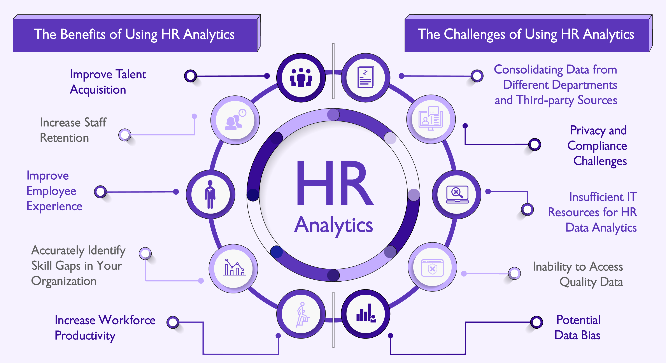

Slide 5
HR Project Objective
This HR project aims to provide comprehensive insights into employee demographics, performance, satisfaction, and attrition trends through visualized data.
The goal is to enhance decision-making by identifying key patterns in workforce composition, job satisfaction, and attrition.
This will allow for better workforce management, employee retention strategies, and targeted training opportunities, ultimately improving organizational performance.

Slide 6
Data Cleaning & Transformation
1. Match Education Degree with Educational Level:
Use the VLOOKUP formula in Excel to align each employee's education degree with their corresponding educational level.
2. Calculate Average Performance:
Group the performance data by employee and calculate the average performance rating for everyone.
3. Replace Codes with Descriptive Legends:
Replace coded values in the dataset (e.g., satisfaction and rating codes) with their descriptive counterparts from the legends.
4. Full State Name Replacement:
Replace state abbreviations in your dataset with the full state names for clearer reporting and analysis.

Slide 7
Company Profile

Slide 8
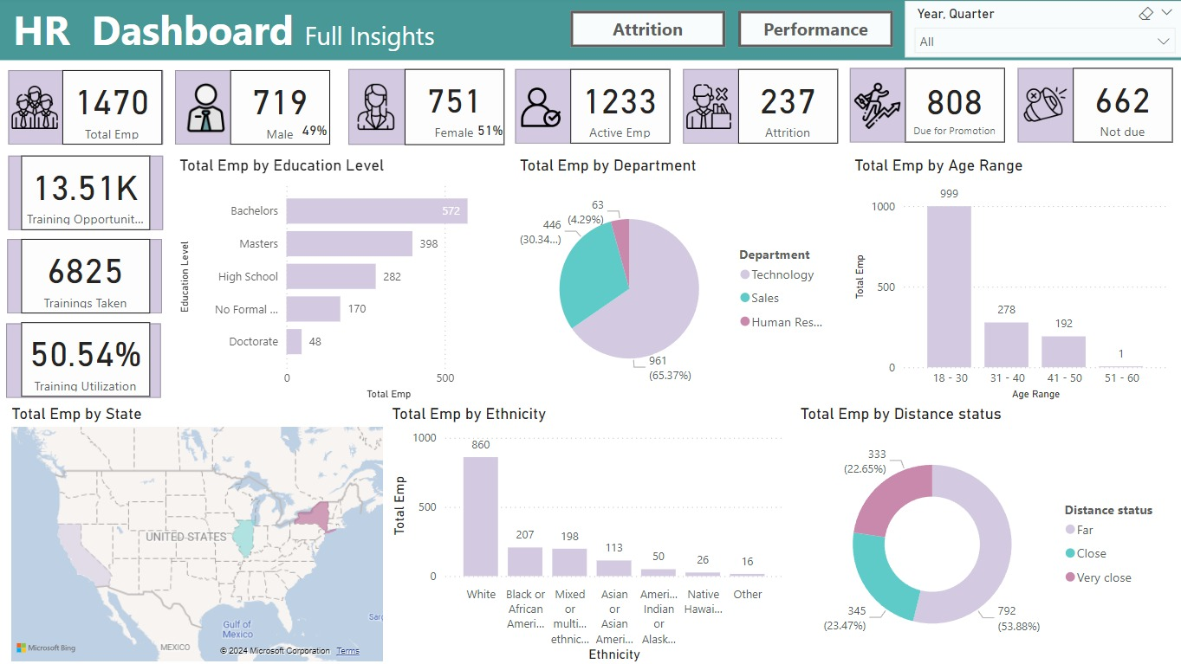
Overview of HR Insights
This dashboard provides a detailed look at employee demographics and attrition.
It helps identify trends and areas of improvement within the workforce.

Slide 9
Analysis Insights:
Employee Demographics
Who Are Our Employees?
Total employees: 1,470
Age Distribution: 18-30 (999), 31-40 (278), 41-50 (192), 51-60 (1)
Gender: Female (51%), Male (49%)
Education: Majority holds Bachelor's (572) and Master’s (398) degrees
Ethnicity: Predominantly White (860), followed by Black/African American (207)
Employee Distance to Workplace
Workplace Commute Insights:
Employee proximity: Far (53.88%), Close (23.47%), Very Close (22.65%)
Long commutes might be linked to higher dissatisfaction or attrition.
Departmental Breakdown
Employee Distribution by Department:
Technology: 65.37%
Sales: 30.3%
HR: 4.29%
Promotion and Training Opportunities
Career Development:
Promotion: 808 employees due for promotion
Training: 14,000 opportunities, 6,825 taken (Training Utilization= 50.54%)
More training can help boost promotion-readiness and performance.

Slide 10
Analysis trends
The workforce has almost an equal balance of men and women, with most employees (68%) being between 18-30 years old. The Technology department has the largest group, making up 65.37% of the staff.
Only 50.54% of employees are using available training programs, suggesting more could participate.
237 employees (16.12%) may leave the company, while 808 are ready for promotion.
The company has a mix of employees from different backgrounds, but the majority (58.5%) are White.
Over half of the employees (53.88%) live far from work, which could affect their engagement with the company.

Slide 11
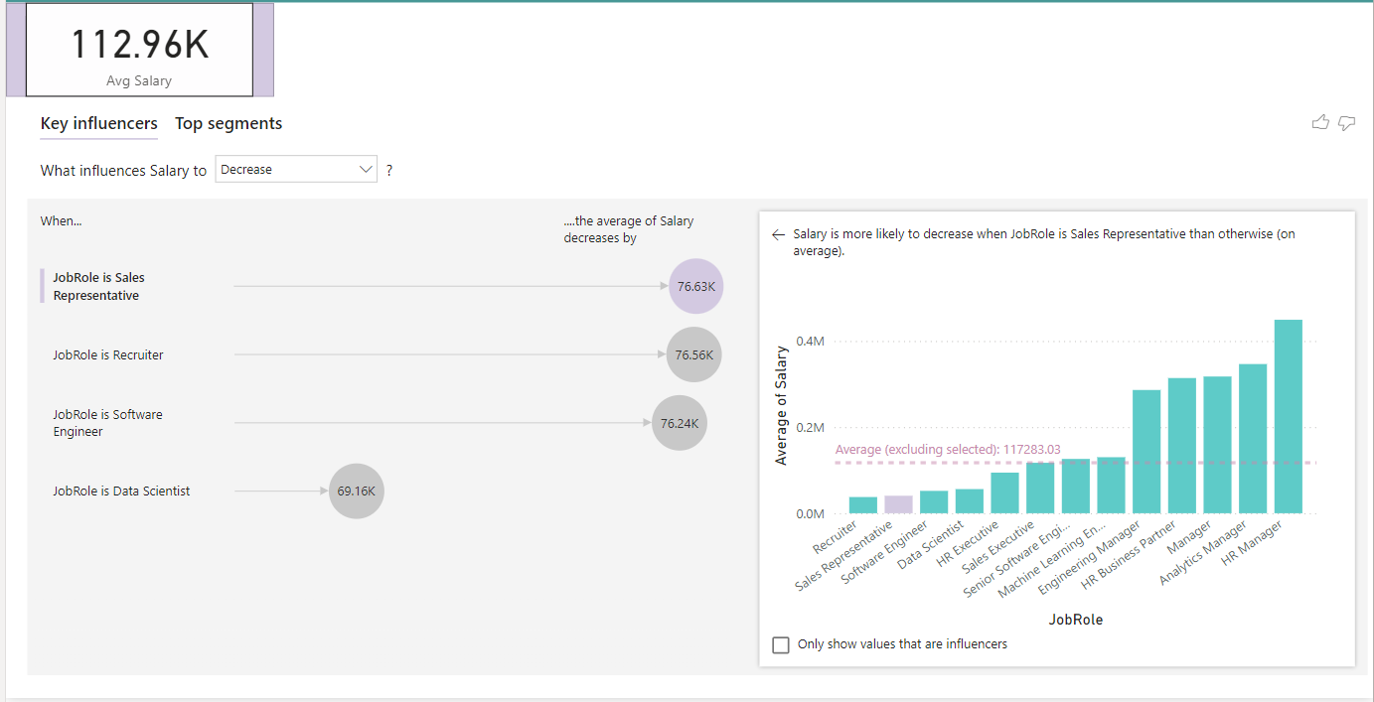
Company Avg Salaries
This HR dashboard shows insights related to salary. The key metric at the top is the average salary, which is $112.96K. The dashboard analyzes factors influencing salary decrease, highlighting the job roles contributing to this trend.
The chart on the left shows that the average salary decreases by:
$76.63K when the job role is Sales Representative.
$76.56K when the job role is Recruiter.
$76.24K when the job role is Software Engineer.
$69.16K when the job role is Data Scientist.
On the right, there's a bar chart comparing the average salary across different job roles. It shows that HR Managers have the highest salaries, while Recruiters and Sales Representatives tend to have lower salaries.

Slide 12
Employees Attrition

Slide 13
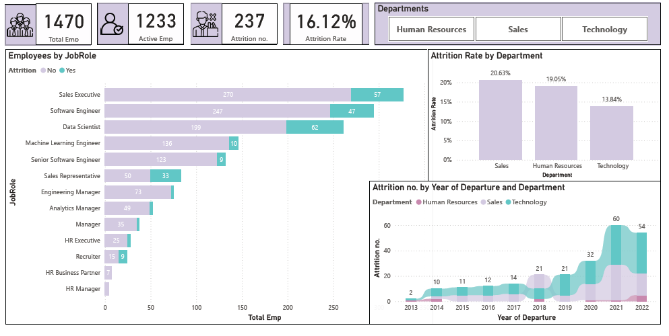
Attrition Analysis

Slide 14
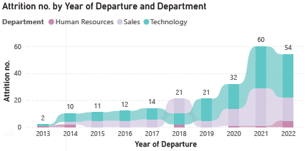
Attrition Trends Over Years

Slide 15
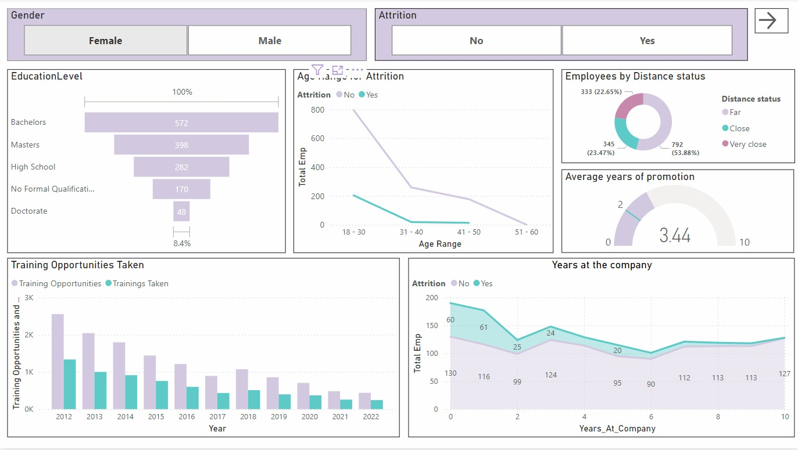
Factors Affect Attrition

Slide 16
Employees Performance

Slide 17
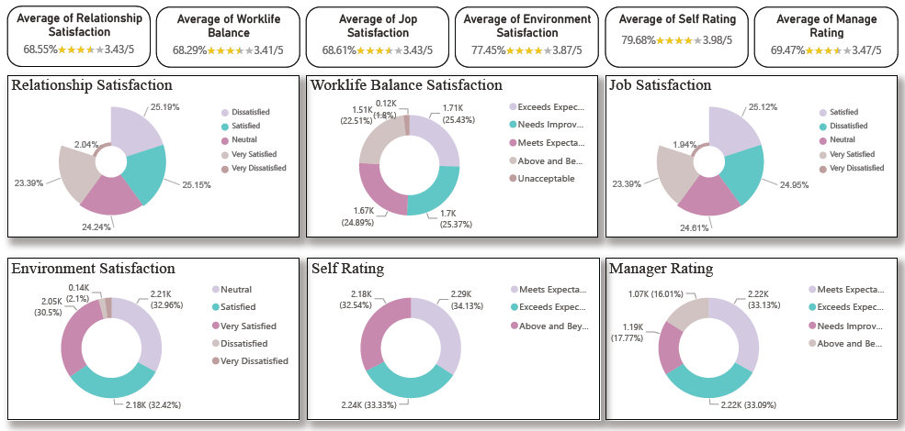
Performance Level among years:
The satisfaction level and the rating level within the company is quite high (above 3.4/5) and convergent ( in average) and (among the employment).
This reflect middle to high satisfaction level and middle to high rating level.
The environment satisfaction and the self rating scored the highest level ( 3.9 and 4 on average respectively)
Performance Level among years:
No significant change in the satisfaction level and the rating level among the years in the 6 measurements.

Slide 18
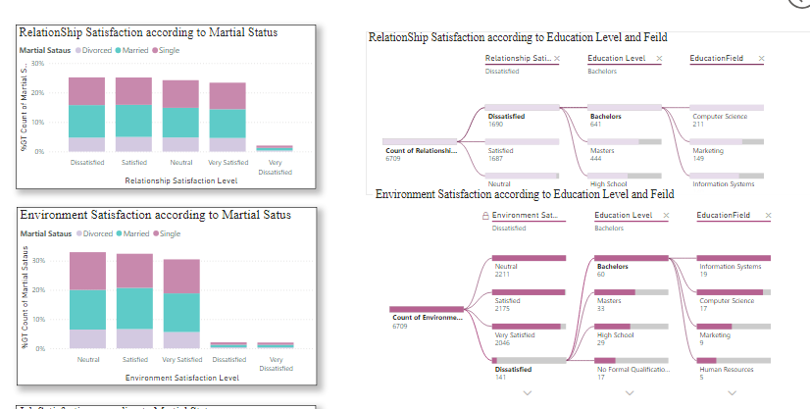
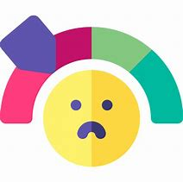
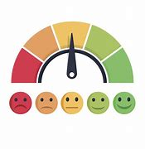
On personal profile level:
Dissatisfactions level among the different variable
Males and female shows the differ in their degree of satisfaction
Age group between 25-28 had the highest dissatisfaction level also.
“White and the mixed ethics” had the dissatisfaction level and thus the lowest self-rating.
“Bachelor’s degree Holders” in the three education fields express high degree of dissatisfaction
The marital status didn’t affect the dissatisfaction r the rating level ( significantly).

Slide 19
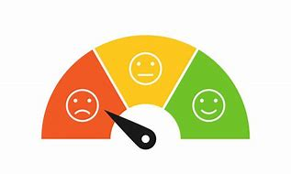
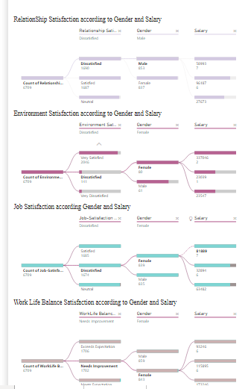

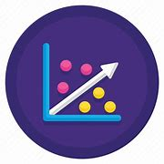
On job profile level:
People with lower salary (earned below 115 K) show high level of dissatisfaction.
On working departments: sales and IT department had the highest degree of dissatisfaction. Thus, sales executives, data scientist and software engineer response prove that.
No any correlation found between the low rating level or low satisfaction level and (years with the same manager, years in the recent role, years at the company and training opportunities).
A positive correlation found between the level of satisfaction and the high rating level, and the average of promotion provided to the employee (except for job satisfaction and relationship satisfaction)

Slide 20
Conclusion

Slide 21
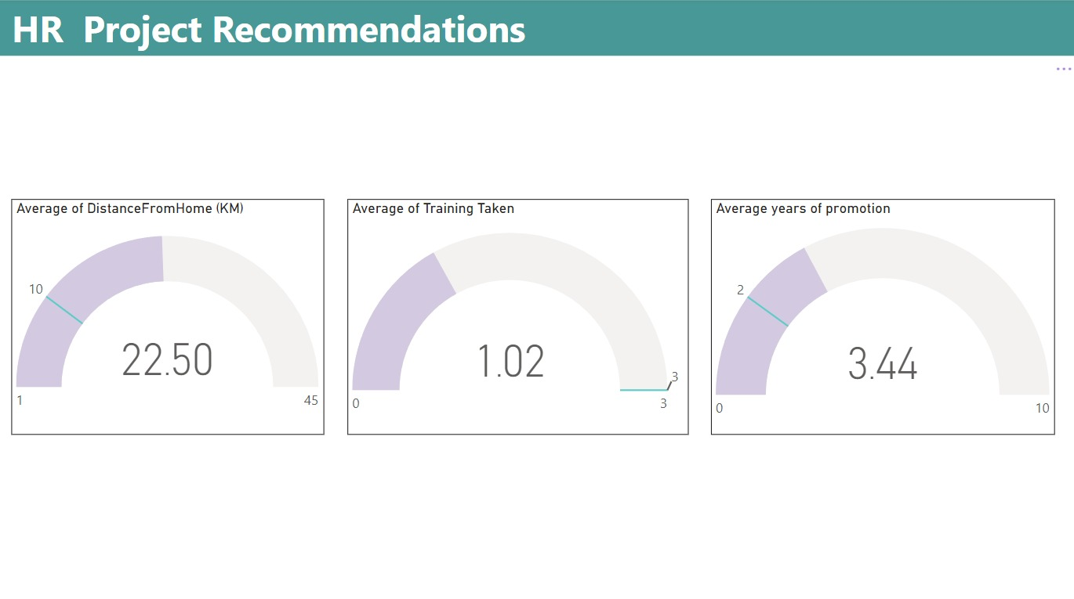
KPI

Slide 22
Conclusion
PROMOTION
SALARY
TRAINING
DISTANCE

Slide 23
Recommendations
Working on minimizing the gap between “ years of promotion” to be 2 years on average instead of 4.5 years
Increase incentives and promotion especially the group provided to the employees in the age (25-30) years
Apply new composition of incentives and promotion rather than the financial incentives is recommended
Set a group of programs to enhance the working environment and the skills of the data scientist and sales executives.
Enhance and increase the training opportunities given to the employment to increase their effect on the performance level.
Enabling remote work
Flexible working hours
Providing transportation for employees

Slide 24


